Slide 1





Predicting Drug Overdose Death Rates
Data Science and Machine learning Final Project

Slide 2
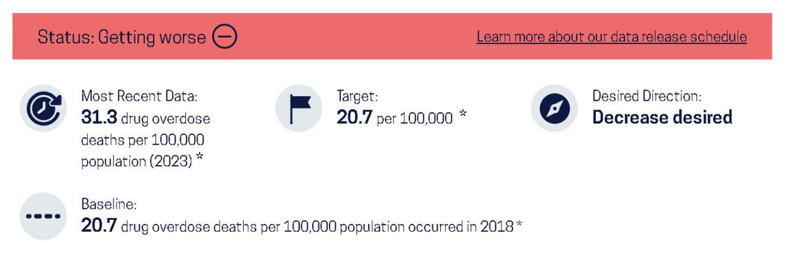

Problem and Data Overview
Goal: Predict drug overdose death rates using socio-economic factors.
U.S Department of Health and Human Services
Original Variables:
INDICATOR: Overdose death rate
PANEL
UNIT
STUB_NAME
YEAR
AGE
📊 Added Variables:
Unemployment Rate
Death Month (seasonal trends)
Drug Involved
Average Weekly Wages
📚 Data Sources
Data.gov
CDC
BLS
🎯 Target Variable
Drug Overdose Death Rate

Slide 3






Methodology
Data
Collection
Data
Enrichment
Data
Preprocessing
Modeling
Approach
Model
Evaluation
Used overdose death dataset
Added extra real-world factors for better prediction.
Added unemployment rate, wages, month, and drug involvement.
These variables help capture economic and seasonal effects.
Cleaned missing data and merged datasets.
Converted text categories into numeric values.
Treated the task as a regression problem.
Tested multiple models (Linear Regression, Random Forest, etc.).
Used RMSE, MAE, and R² to measure performance.
Chose the model with the best accuracy

Slide 4
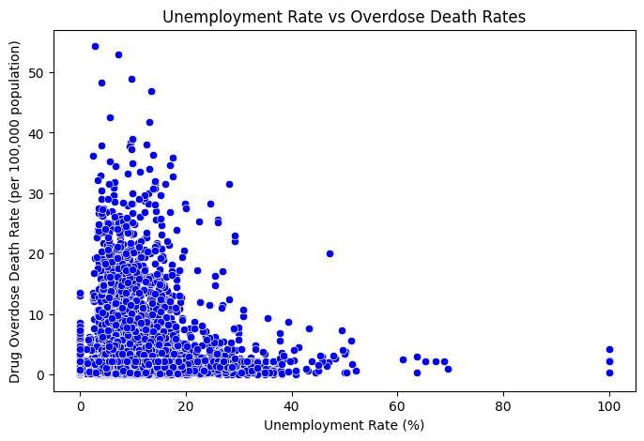
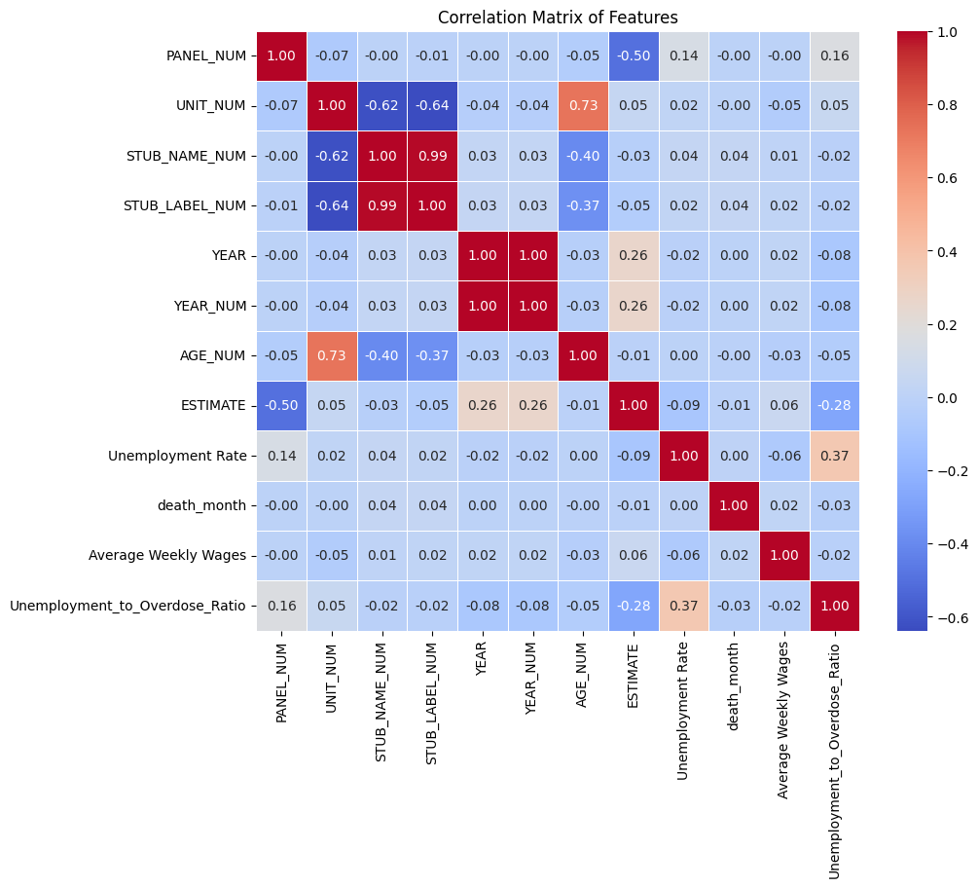

Slide 5
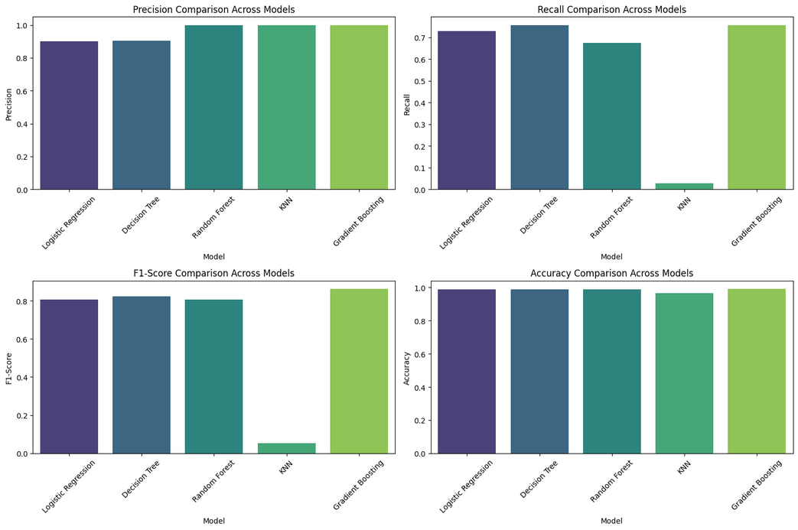

Slide 6
Implication & Recommendation
economic variables influence overdose prediction e.g Unemployment to overdose positive correlation 0.37
Gradient Boosting has the strongest classification metrics
overdose deaths are not driven by a single demographic variable
Strengthen Support in Economically Stressed Areas
Adopt Predictive Modeling Tools in Public Health Planning model like Gradient Boosting for overdose trends and HIgh risk areas

Slide 7
Thank You!
Questions?

